Slide 1


Coding Night @ Zuhlke UK
Daniel
Philippe

Slide 2
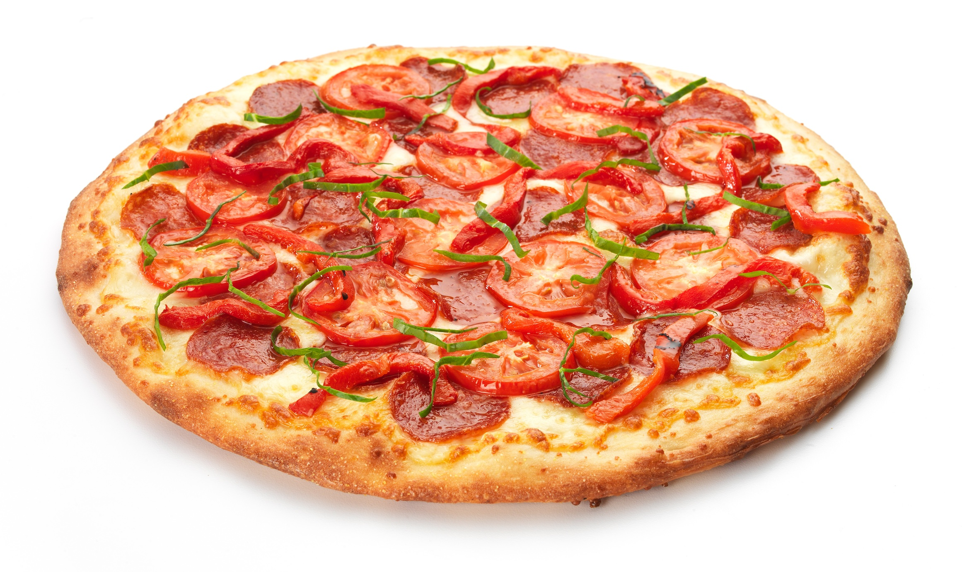
Agenda
Introduction (5’)
The Challenge (60’)
Pizza & Beer (30’)
Showtime (20’)
Mini retro (10’)

Slide 3
1. Introduction
Imported from
Takes place on the 1st Wednesday of the month
Various formats (live coding, in pairs, alone or a mixture)
Various sorts of challenges (Coding Dojos, ban keywords, object Calisthenics, …)
Notes:
http://williamdurand.fr/2013/06/03/object-calisthenics/

Slide 4
Objectives
Experiment
Fail
Learn
Repeat
Share!

Slide 5
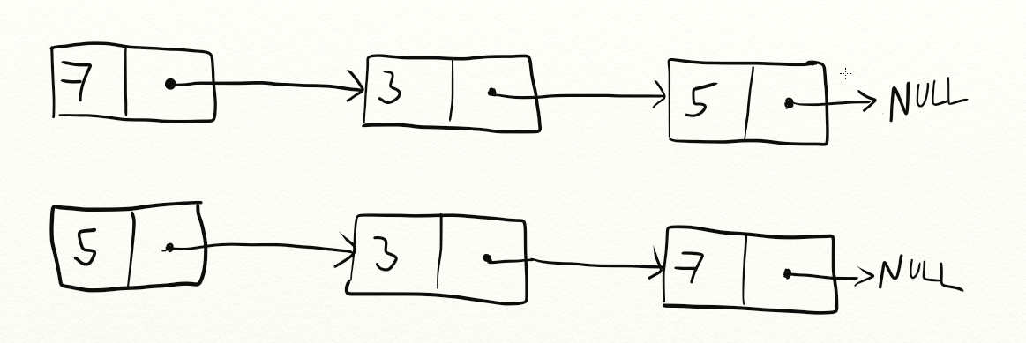
2. The Challenge

Slide 6

2. The Challenge – Skeleton
Git & Node installed?
git clone https://github.com/0x7E0/001-CodingNight-ReverseList.git
cd 001-CodingNight-ReverseList
npm install
npm test

Slide 7




2. The Challenge – Skeleton
Revealing Module Pattern
Hoisting

Slide 8

Let’s Code…
Until 19:40

Slide 9
3. Pizza Time!

Slide 10
4. Showtime!

Slide 11
5. Mini Retro
Domino’s?
Colder beer
1h was ok
Good challenge
18:00/30 is ok
Which day?
Ask for skeleton in different languages

Slide 12


